Slide 1


Space-charge effects in simulations of large avalanche dynamics
Tom Szwarcer | University of Oxford
Supervisors: Djunes Janssens, Heinrich Schindler

Slide 2
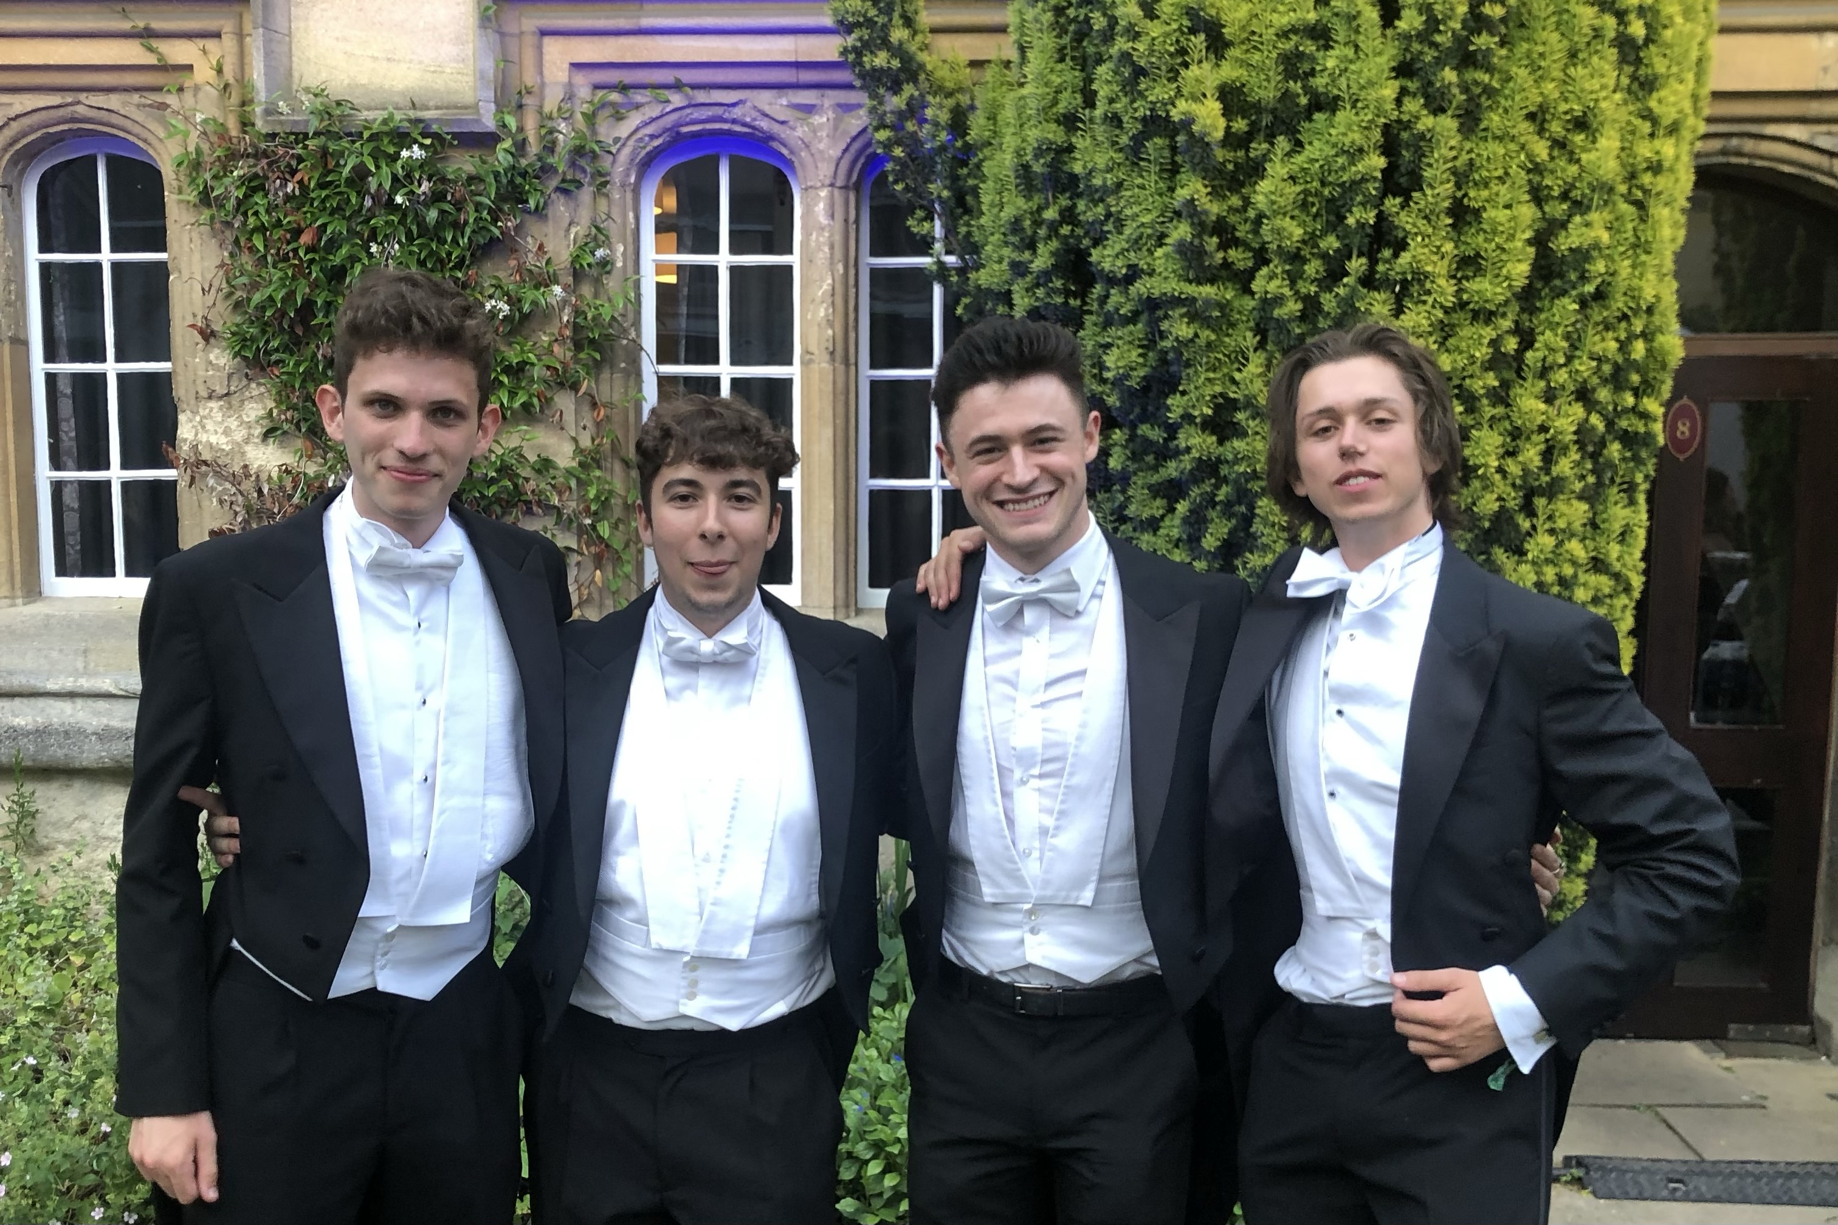
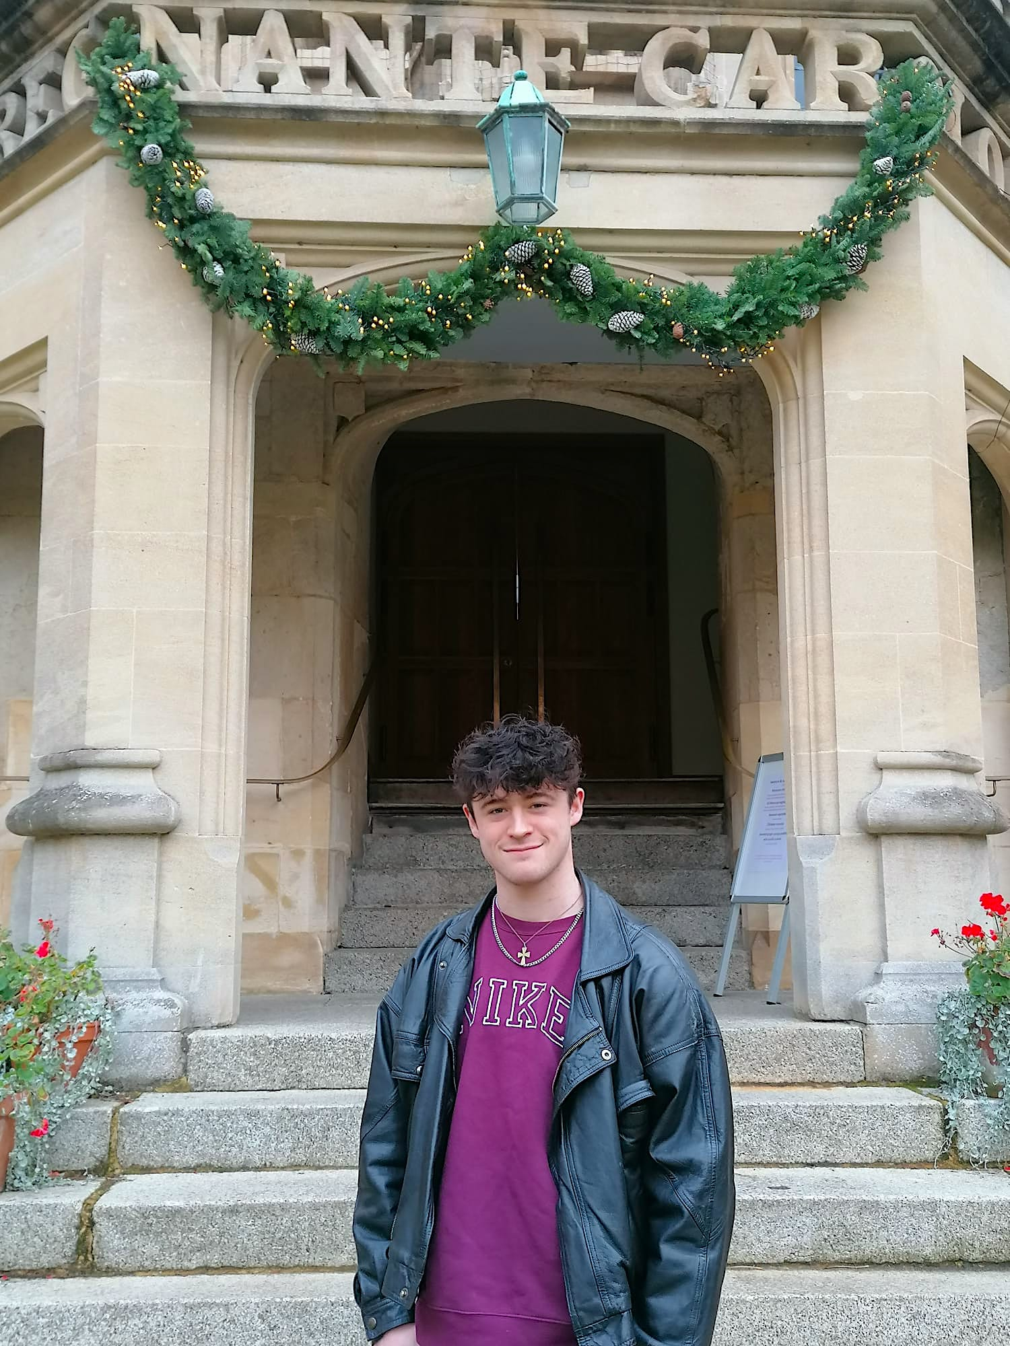
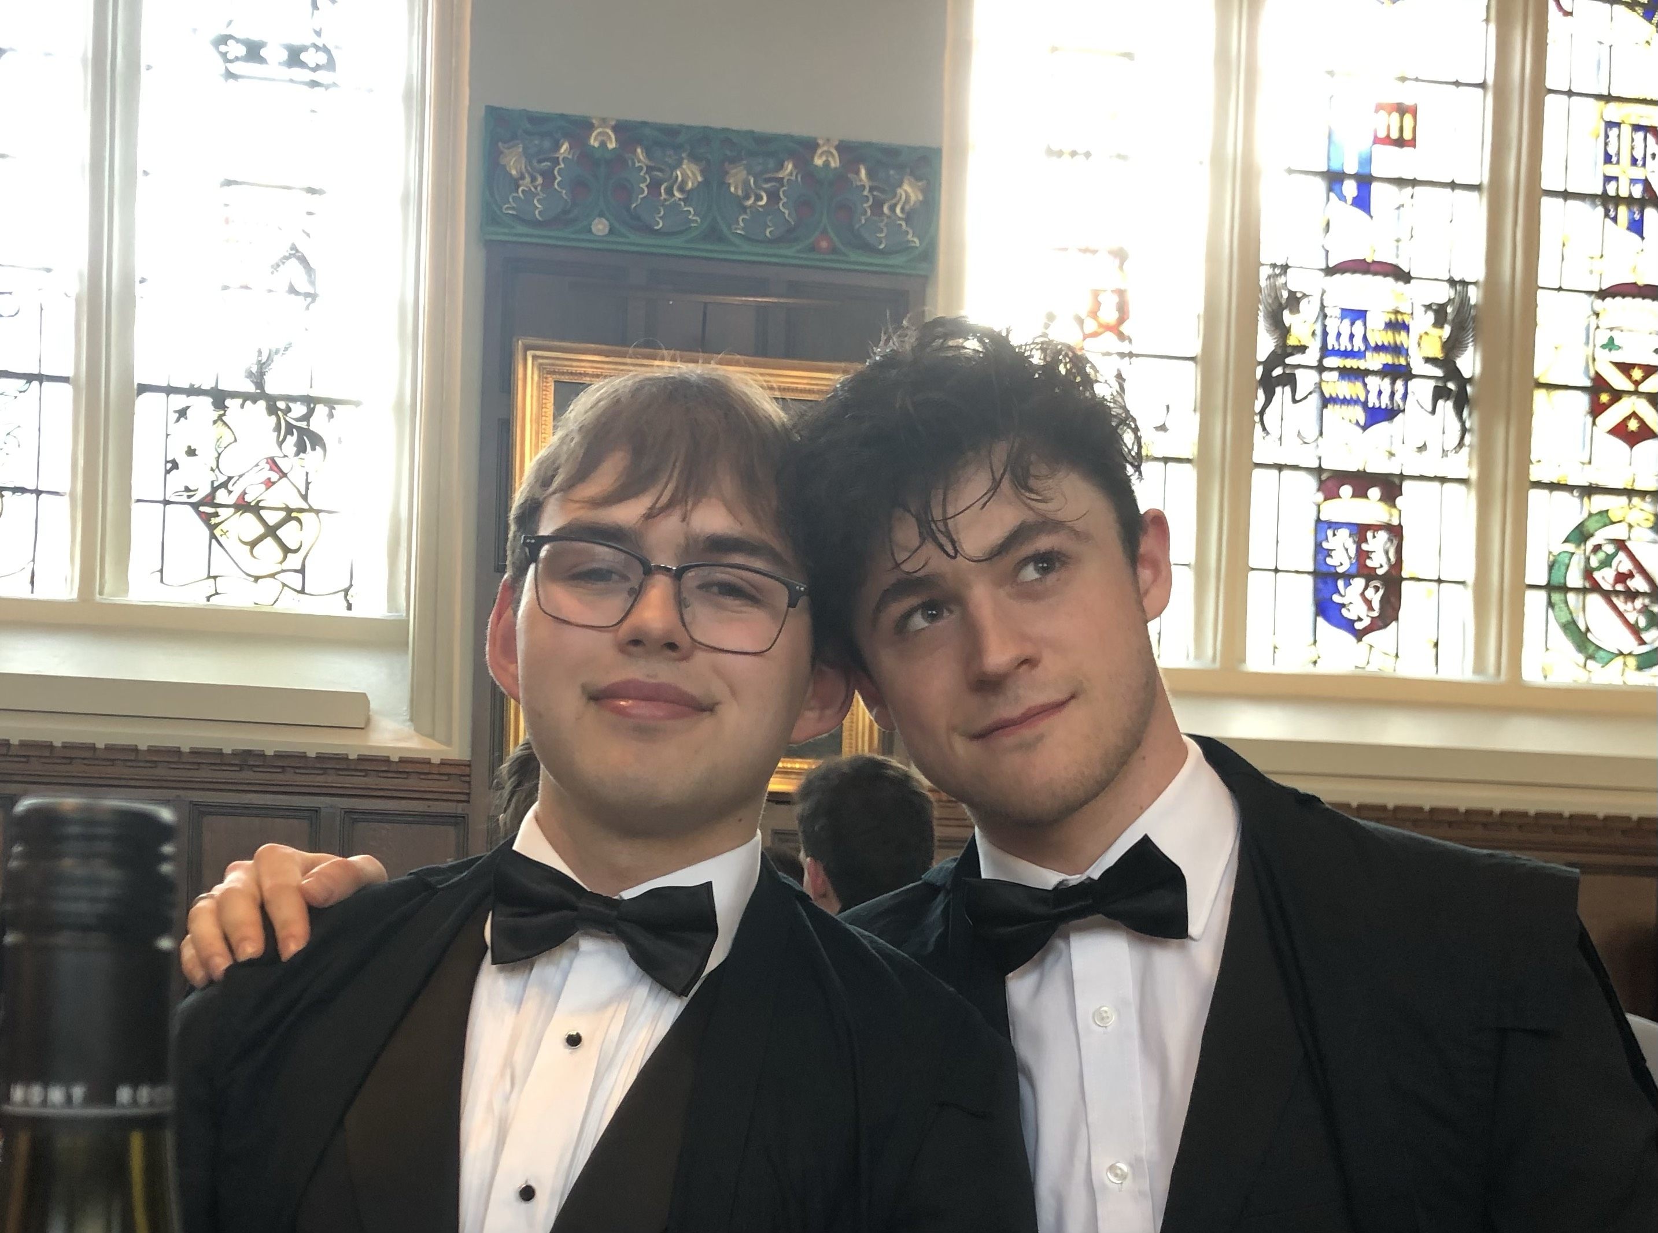
Introduction & experience
Physics student at Oriel College, Oxford
Starting Master’s course this year
Worked with the MIGDAL collaboration (STFC, RAL) in summer 2024, simulating their GEM system in Garfield++

Slide 3
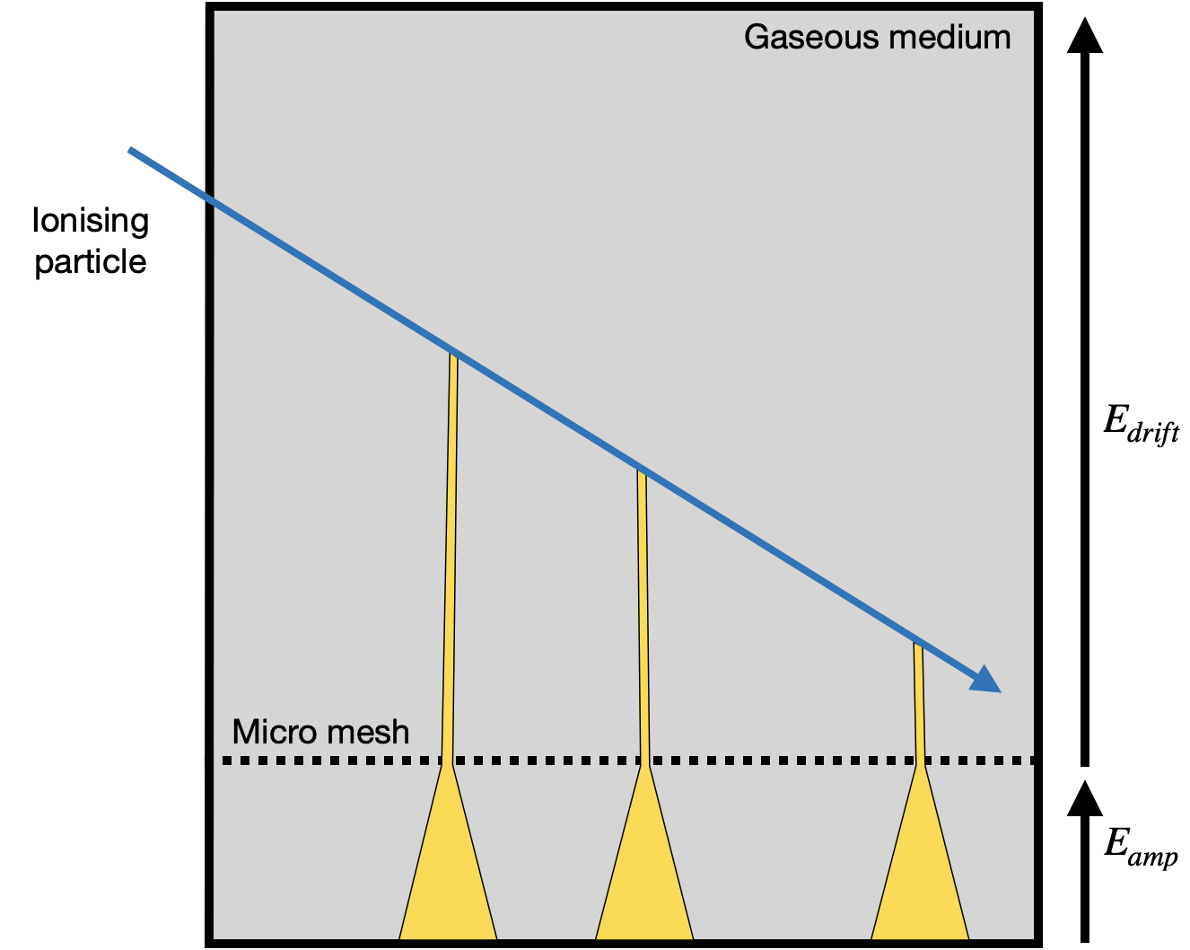
Gaseous detectors
Operational principles
Ionising particles transfer energy to a volume of gas
Charges produced in these interactions are accelerated by electric fields
Electron collisions with gas particles may result in further ionisations (avalanche)
The multiplied charge may induce a detectable signal
The micromegas, a micropattern gaseous detector (MPGD)

Slide 4

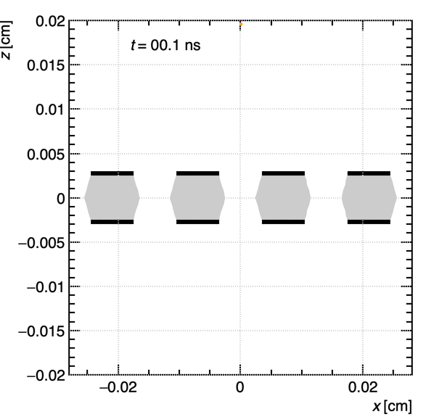
Gaseous detectors
Simulations
Garfield++ is an open-source tool capable of accurate simulations of gaseous and semiconductor detectors
The user can define geometry, electric fields, gas mixtures, etc.
Support for end-to-end simulations, from incoming tracks to signals
ions
electrons
Djunes Janssens, DRD1 Gaseous Detectors School 2024 (indi.to/XZ4YP)

Slide 5
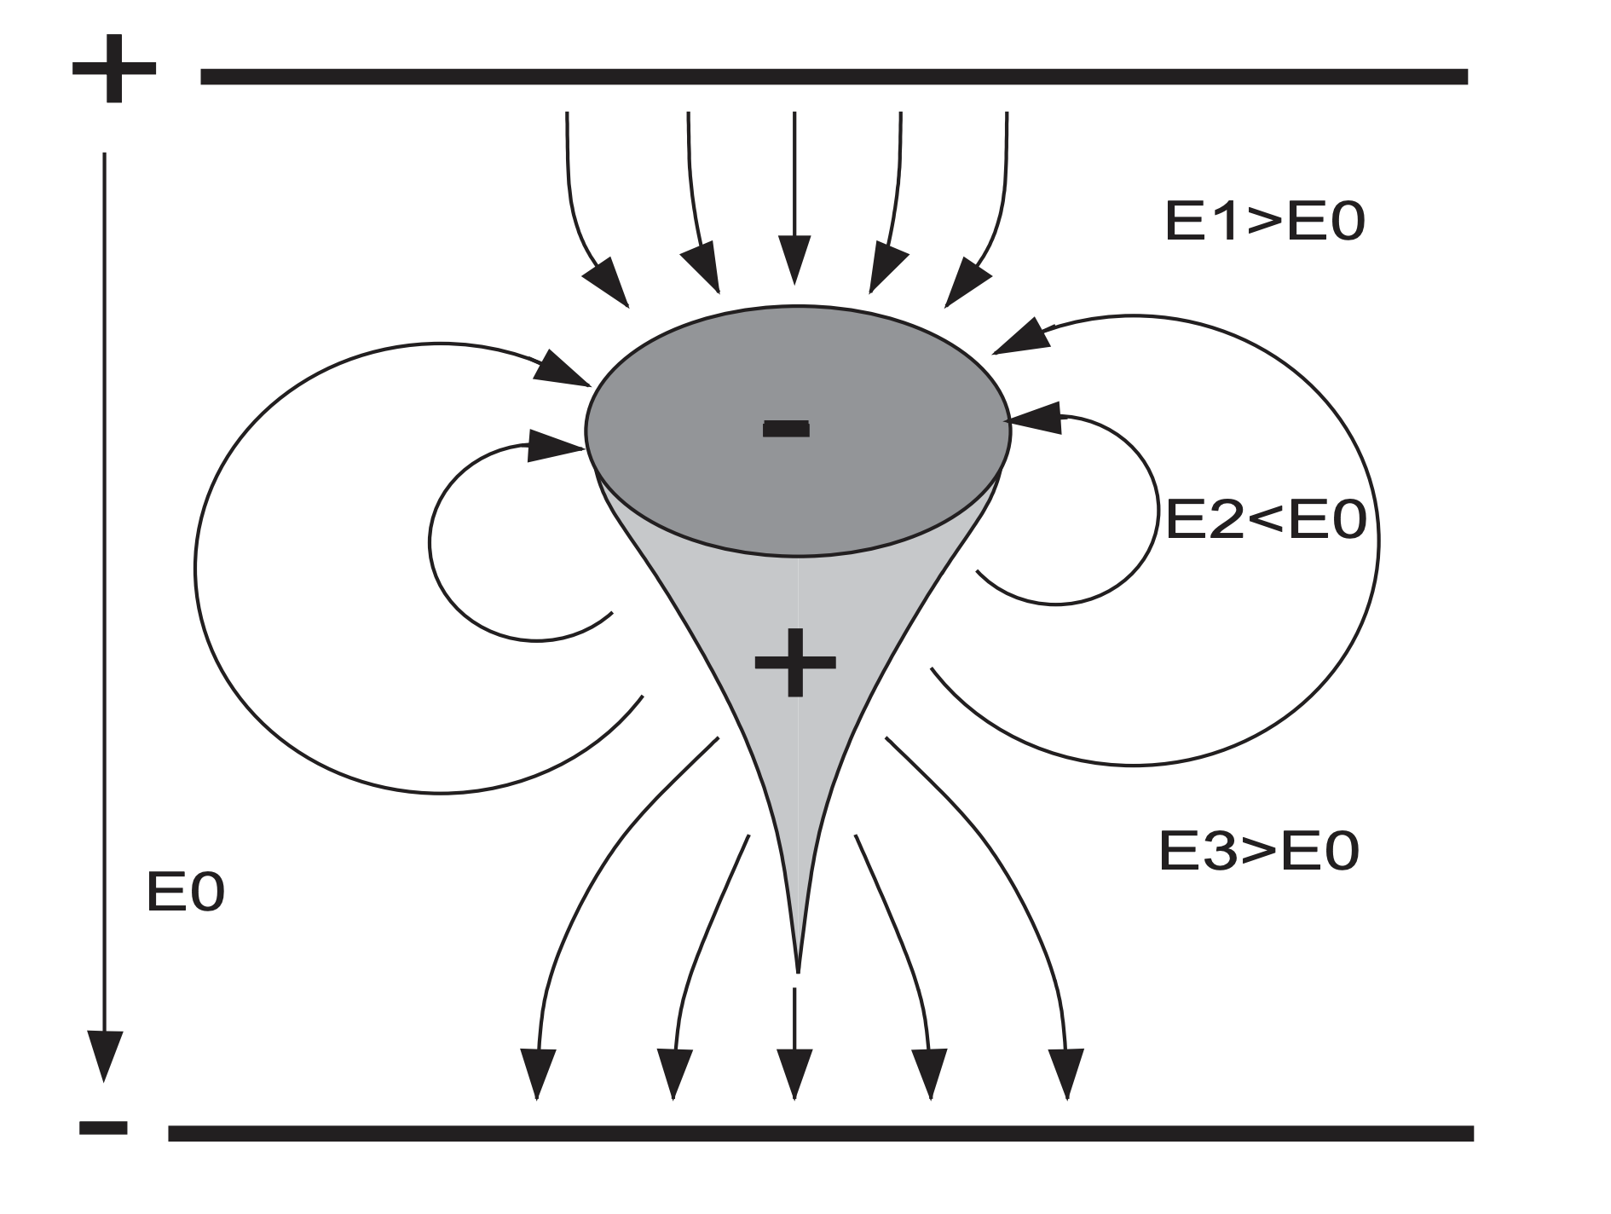
The space charge effect
During avalanches, non-negligible fields may arise from the space charge distribution
These charges modify the background applied field
This may modify the gain
C. Lippmann, W. Riegler, Nuclear Instruments and Methods in Physics Research A 517 (2004) 54–76

Slide 6
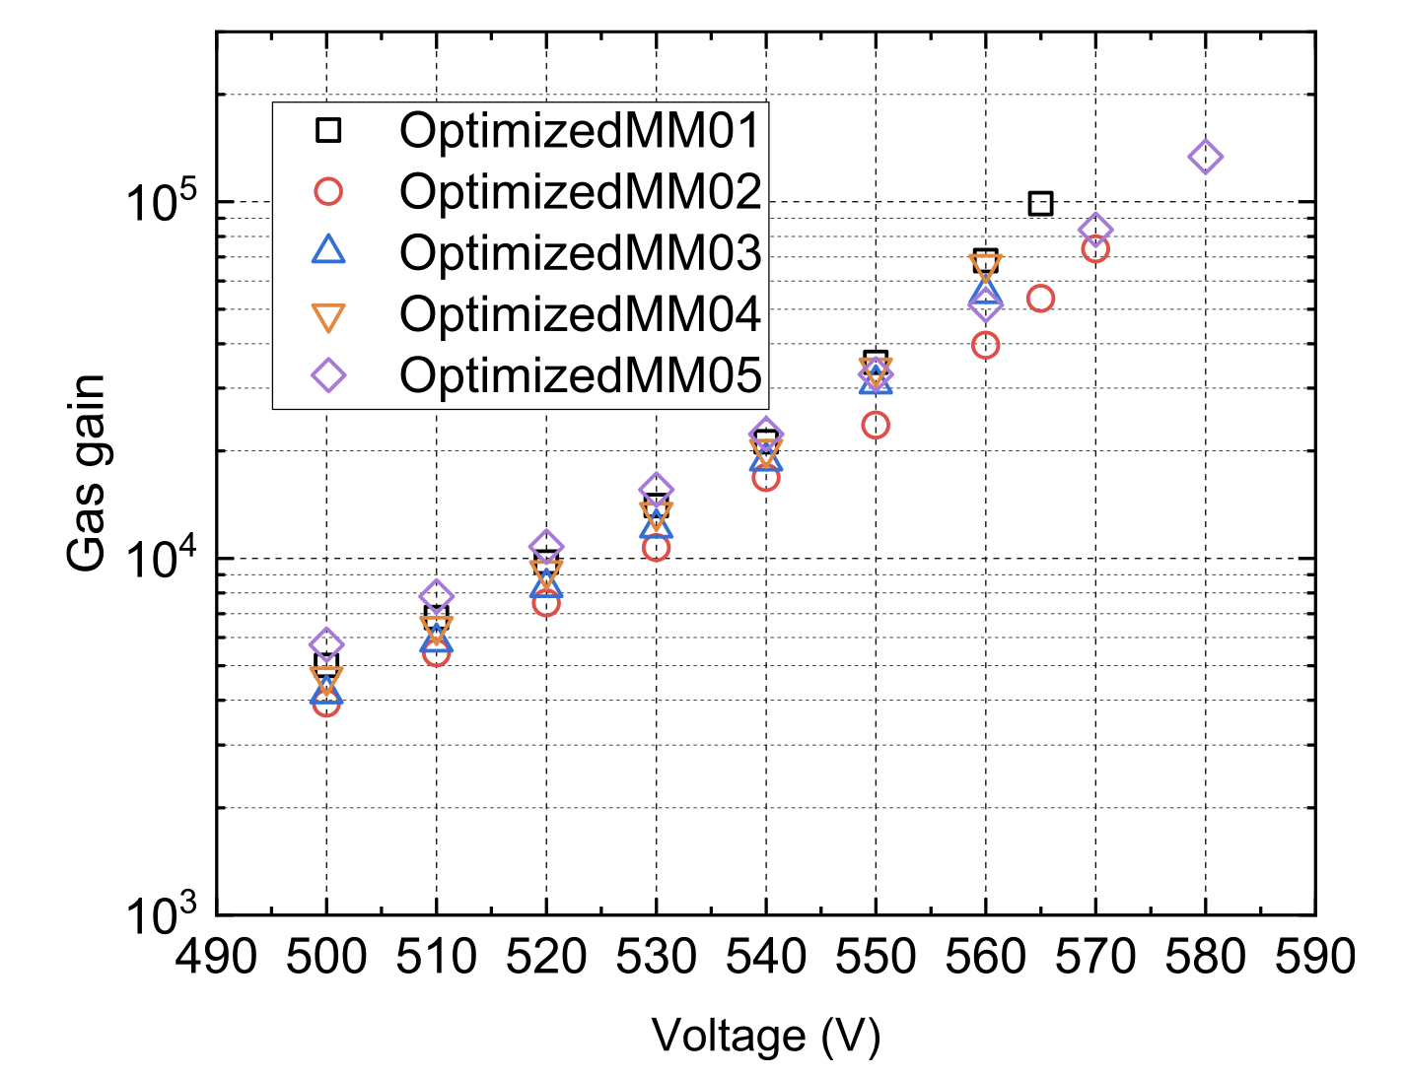
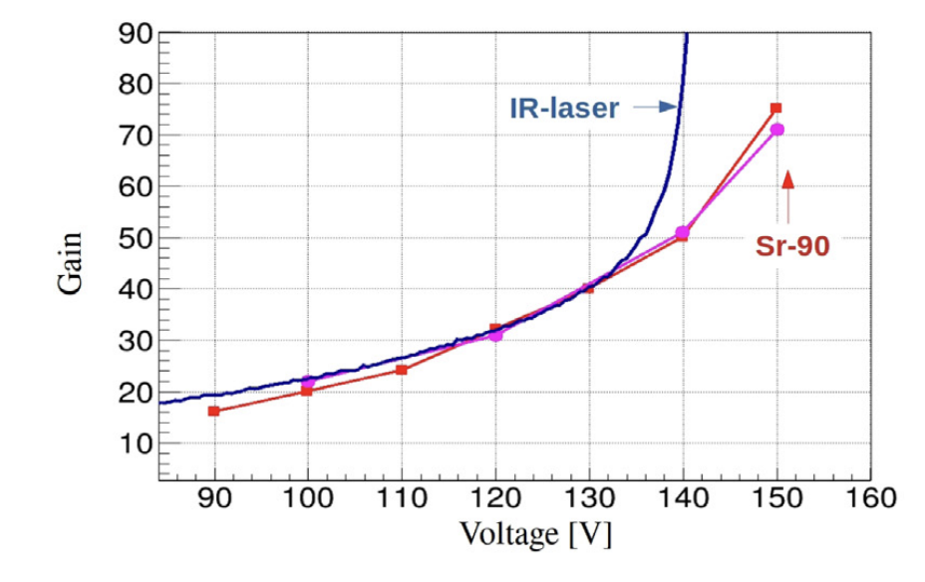
The space charge effect
J. Feng, Z. Zhang, J. Liu et al. Nuclear Inst. and Methods in Physics Research, A 989 (2021) 164958
RPCs: we see a gain-limiting effect
Micromegas: we see superexponential gain
LGADs: we see a gain reduction for a larger number of starting charges
We would like to:
understand this behaviour better
take the space charge effect into account in our simulations
E. Currás, M. Fernández and M. Moll, Nuclear Inst. and Methods in Physics Research, A 1031 (2022) 166530
Top: superexponential gain for high voltages
Bottom: LGAD gain reduction with the higher charge deposition of the Sr-90 source compared to IR laser.

Slide 7
Project overview
Add the space charge effect to Garfield++ microscopic simulations
Investigate the accuracy and efficiency of the following semi-analytical approaches:
Axisymmetric rings of charge in free space
Point charges in a parallel plate
Compare the free-space approximation against a parallel plate boundary condition
Can we get away with treating our charges as free?

Slide 8
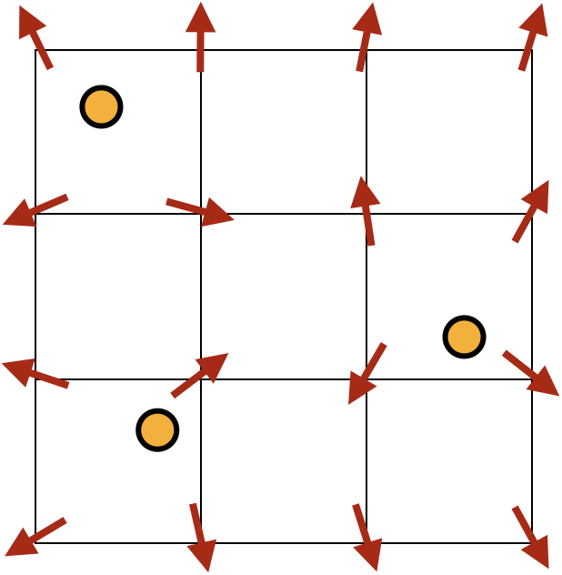
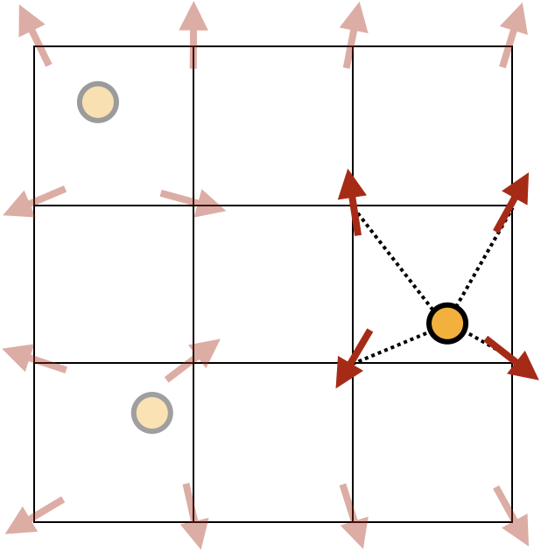
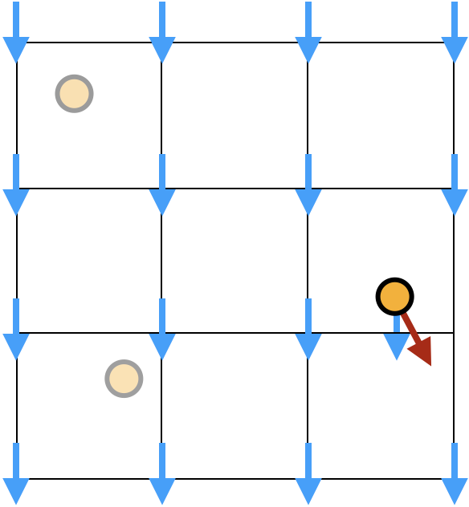
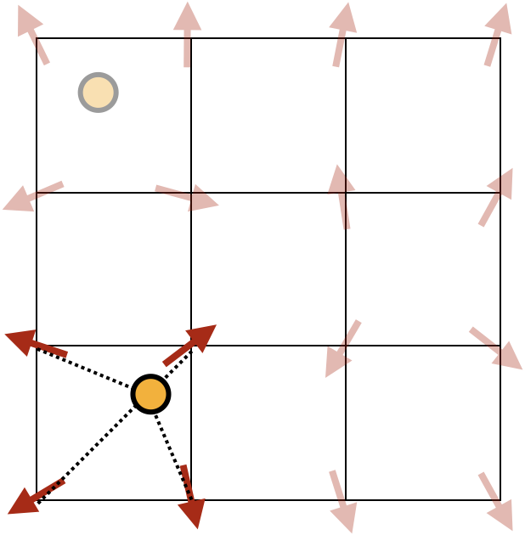
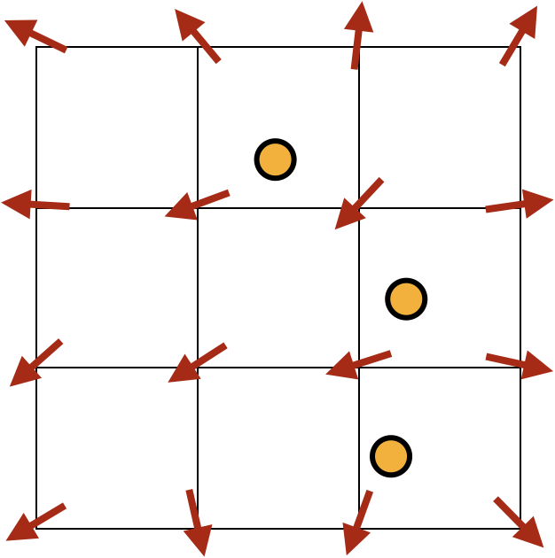
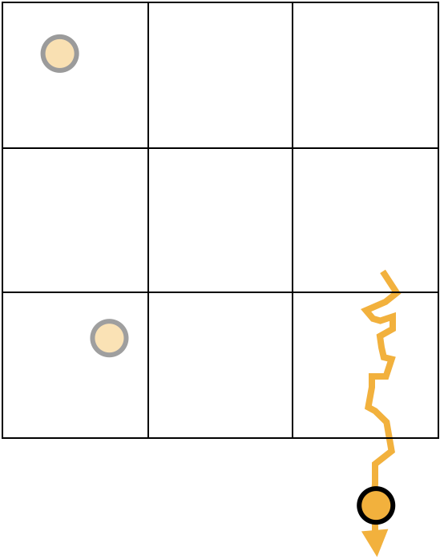
The grid-based approach in microscopic simulations
Background field
Local field
2. Find the local field at a charge’s position by interpolating the field from the nearest nodes
1. Calculate field on the grid nodes from the distribution of charges
3. Add this to the background field at the charge’s position
Local field
6. When all charges have been drifted, recalculate the field for the resulting charge distribution
4. Drift the charge in the presence of these fields
5. Repeat from step 2 for the other charges

Slide 9
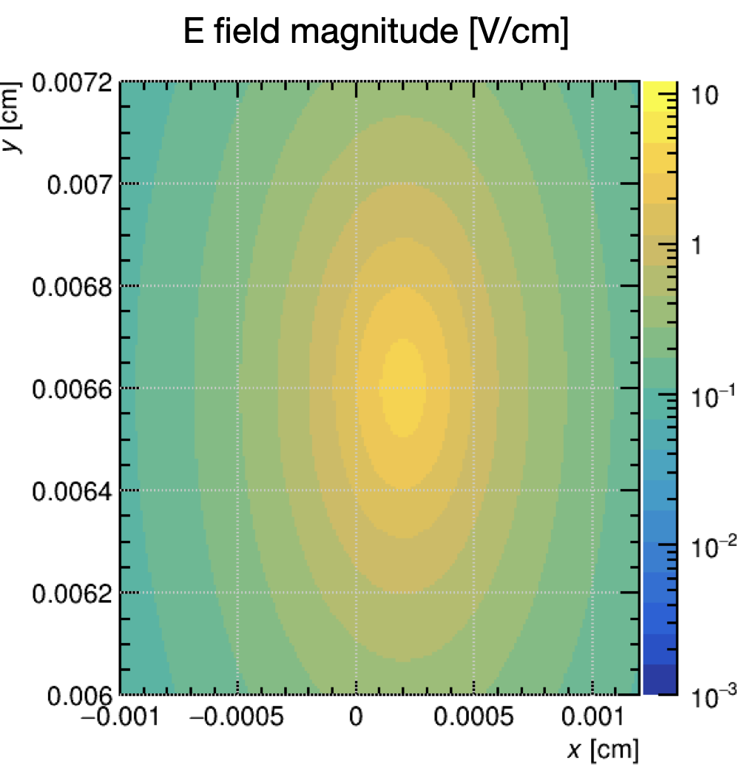
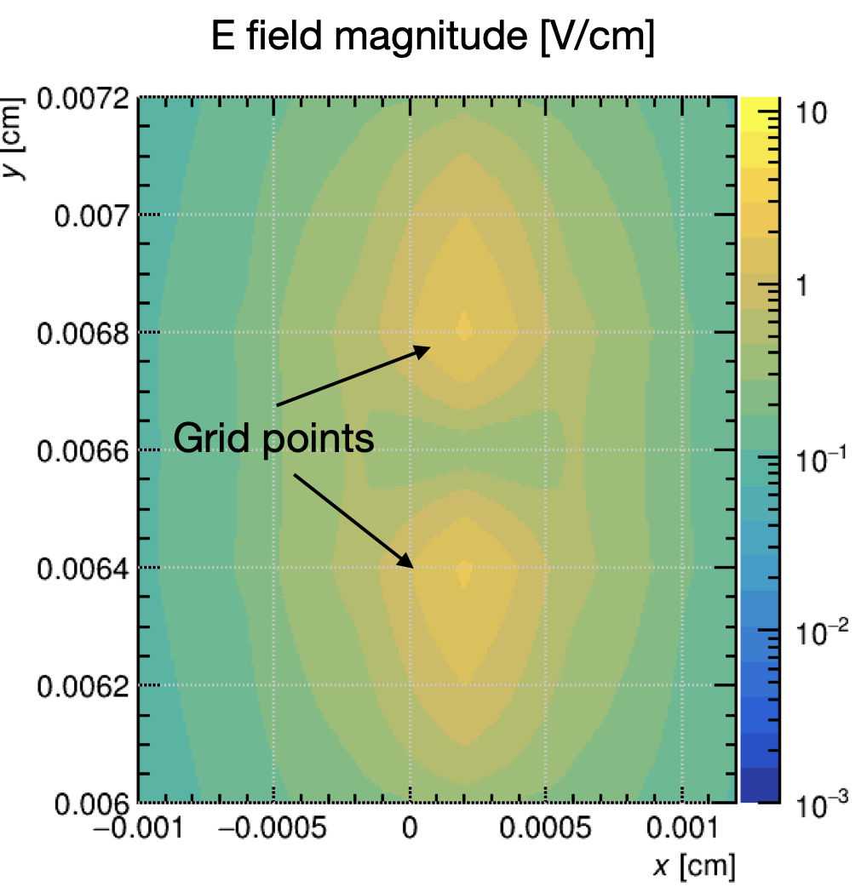
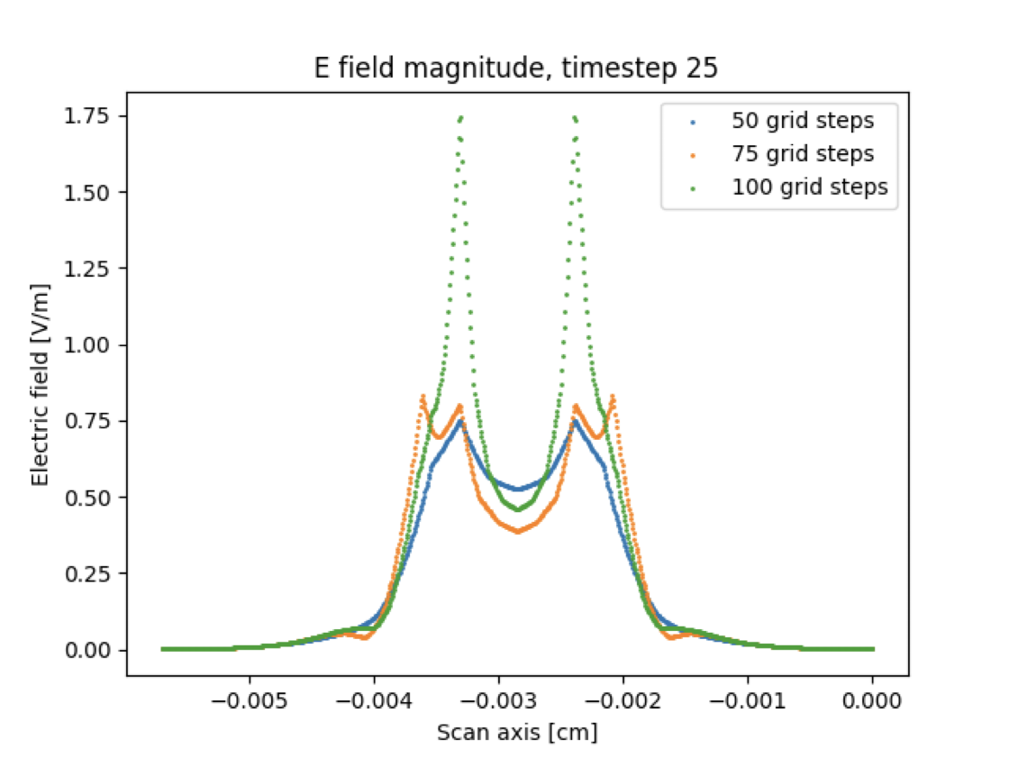
Grid-based approach
Store electric field on grid nodes and interpolate to points in between
Advantages:
Reduces recalculation of computationally expensive fields (elliptic integrals, Bessel function integrals)
We can use pre-computed field maps to further reduce computation time, if we snap particles to a grid point and load the field map for that point
Disadvantages:
Interpolation between nodes causes a splitting of the field
Field can be a strong function of grid spacing due to divergences being sampled at the grid nodes
Before interpolation
After interpolation
Top: splitting of a point charge field due to interpolation Bottom: strong dependence of field on grid spacing for coarse grids in the axisymmetric approximation
[V/cm]

Slide 10
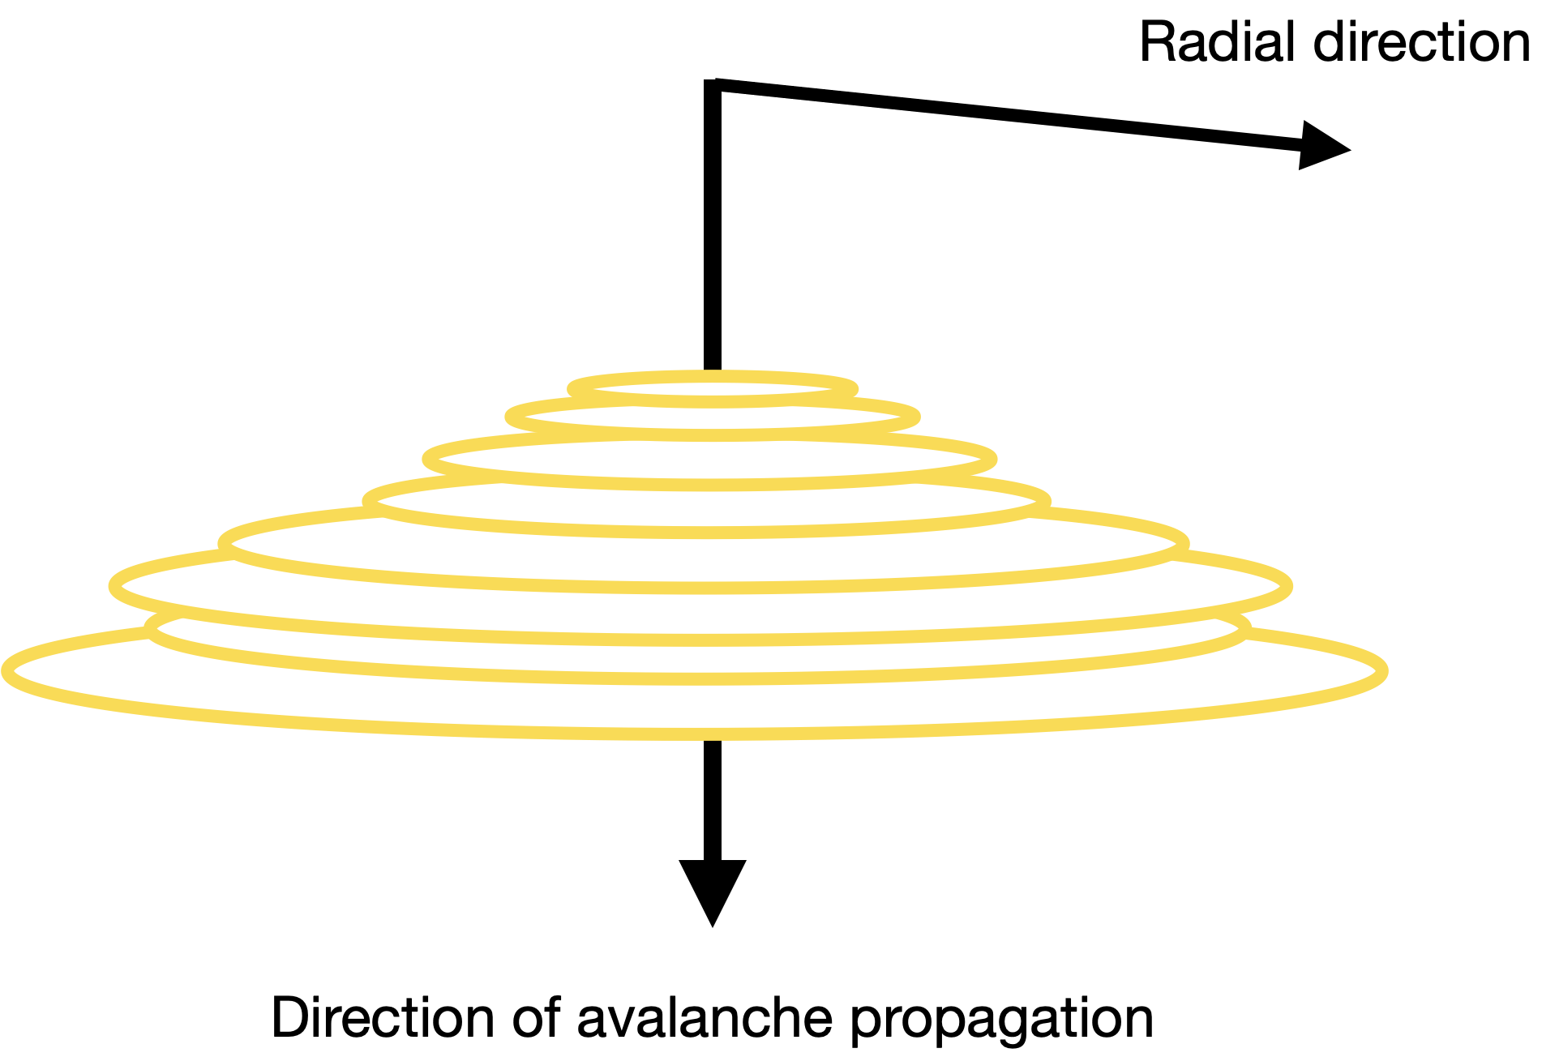
Axisymmetric approximation
Approximate the avalanche as having cylindrical symmetry
The radius is centred on the mean position of the particles
Point charges become charged rings
No grid used
Electric field is calculated as required, at the position of each charge
A ring separation tolerance is used:
To merge two rings that are closer together than this tolerance
To count new rings with r < tolerance as point charges on the symmetry axis
Free space boundary condition used
Based on the work of C. Lippmann, W. Riegler, Nuclear Instruments and Methods in Physics Research A 517 (2004) 54–76

Slide 11
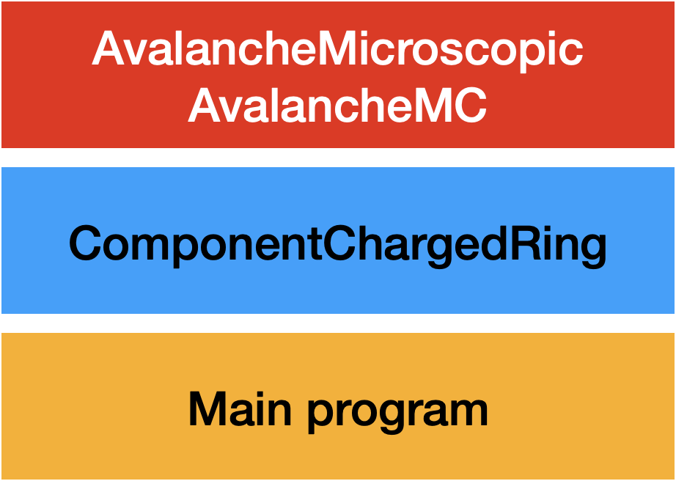
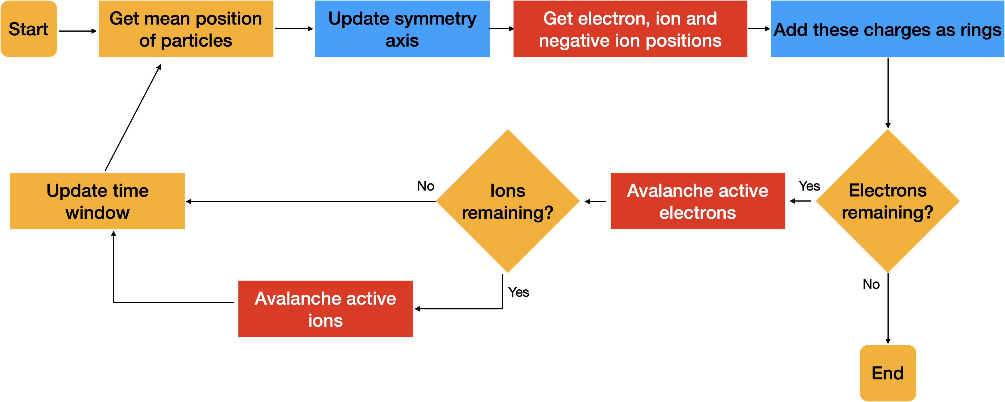
Structure of the simulation
Divide simulations into time windows of width dt
In each window, simulate electrons and ions alternately
Add any new charges (e.g. from ionisation) after the time window

Slide 12
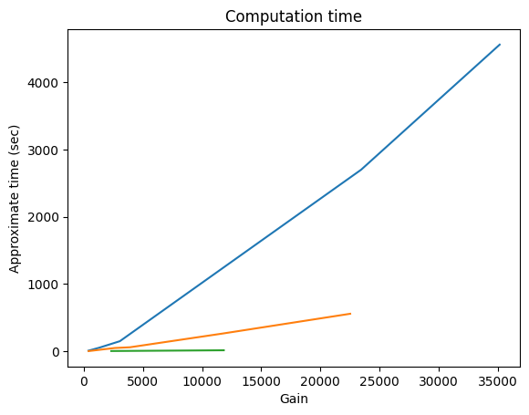
ComponentChargedRing
Existing grid-based code in AvalancheGridSpaceCharge was refactored into a new class that supports a grid-free axisymmetric treatment of space charge
New functions were added to implement a dynamic symmetry axis and catch divergences
Code was profiled line-by-line with valgrind/callgrind
Optimisations were made, reducing computation time significantly
Space charge on, no optimisation
Space charge on, optimised
Space charge off

Slide 13
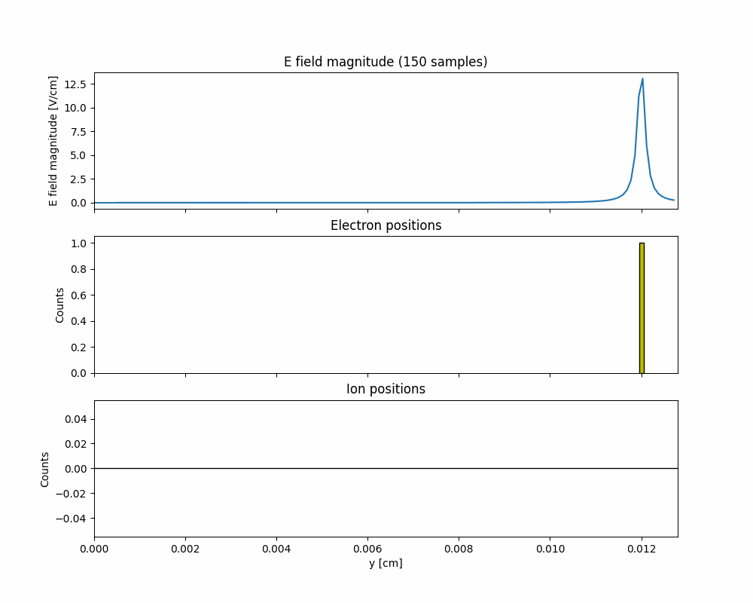
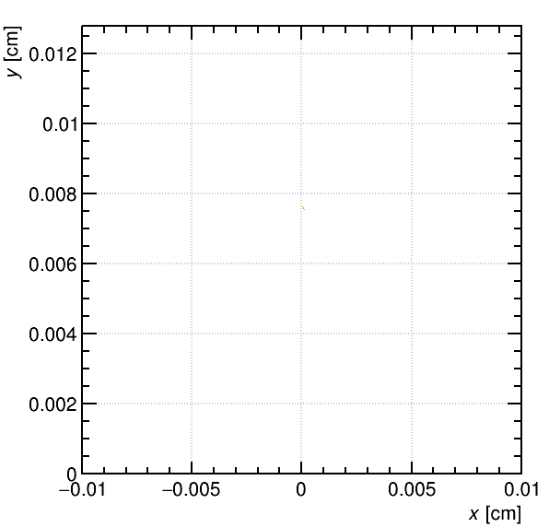
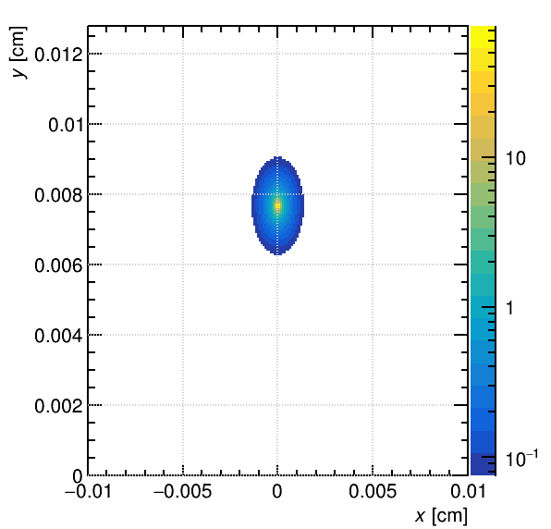
Visualising the space charge field
E field magnitude [V/cm]
Gain: 12637
GIFs viewable at https://github.com/tomszwarcer/spacecharge-sim

Slide 14
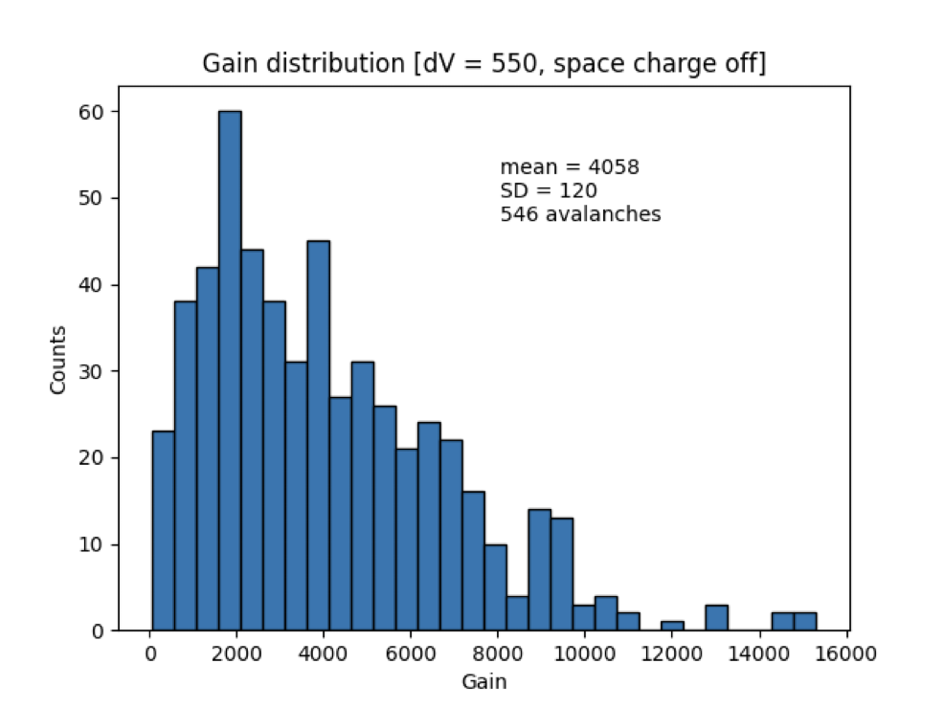
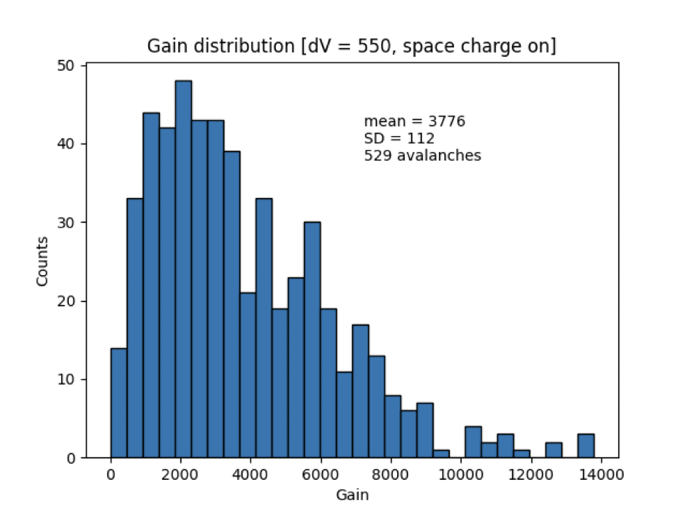
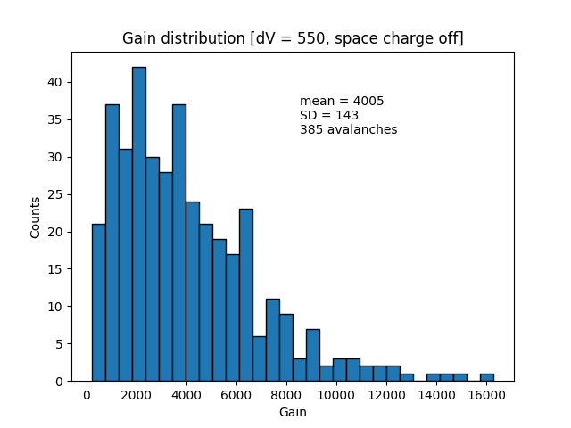
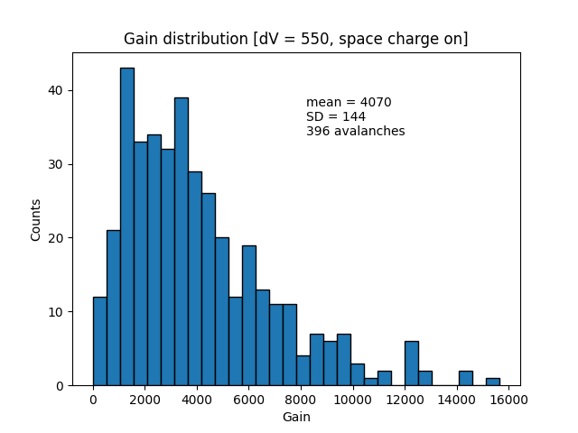
Gain spectra: time window
Simulations run in a parallel plate geometry
For longer time windows, we see a gain decrease at low gain
The effect disappears for shorter time windows
In real detectors, gain modifying effects happen at around:
10⁵ (resistive micromegas)
10⁶ (RPC)
So, this is unexpected
dt = 50 ps
dt = 25 ps

Slide 15
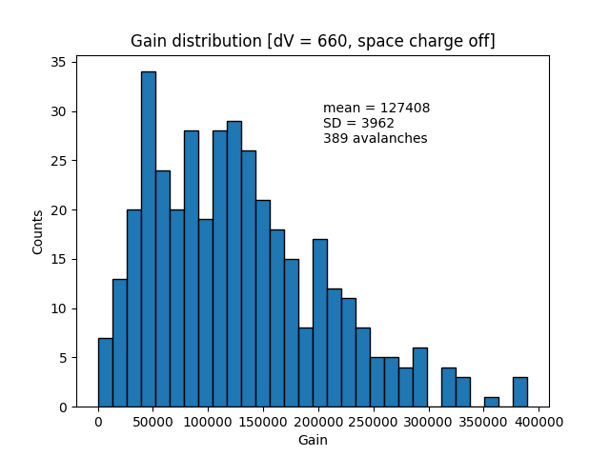
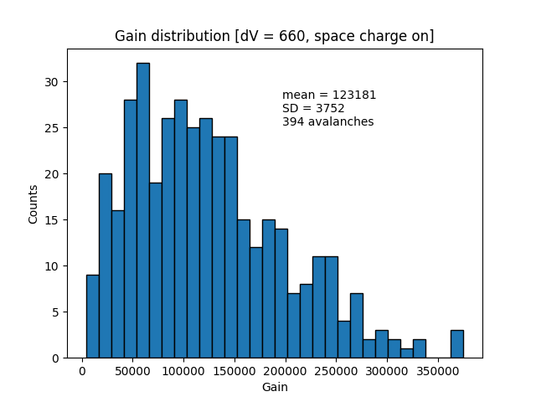
Gain spectra: high gain
For higher gains we see a decrease, but it’s not very statistically significant
More avalanches should be run, but computation time/resources are limiting factors
Thanks to optimisations, these simulations could be run at dt = 2.5 ps (compared to 50ps)
This prevented large numbers of new charges from being unaccounted for

Slide 16
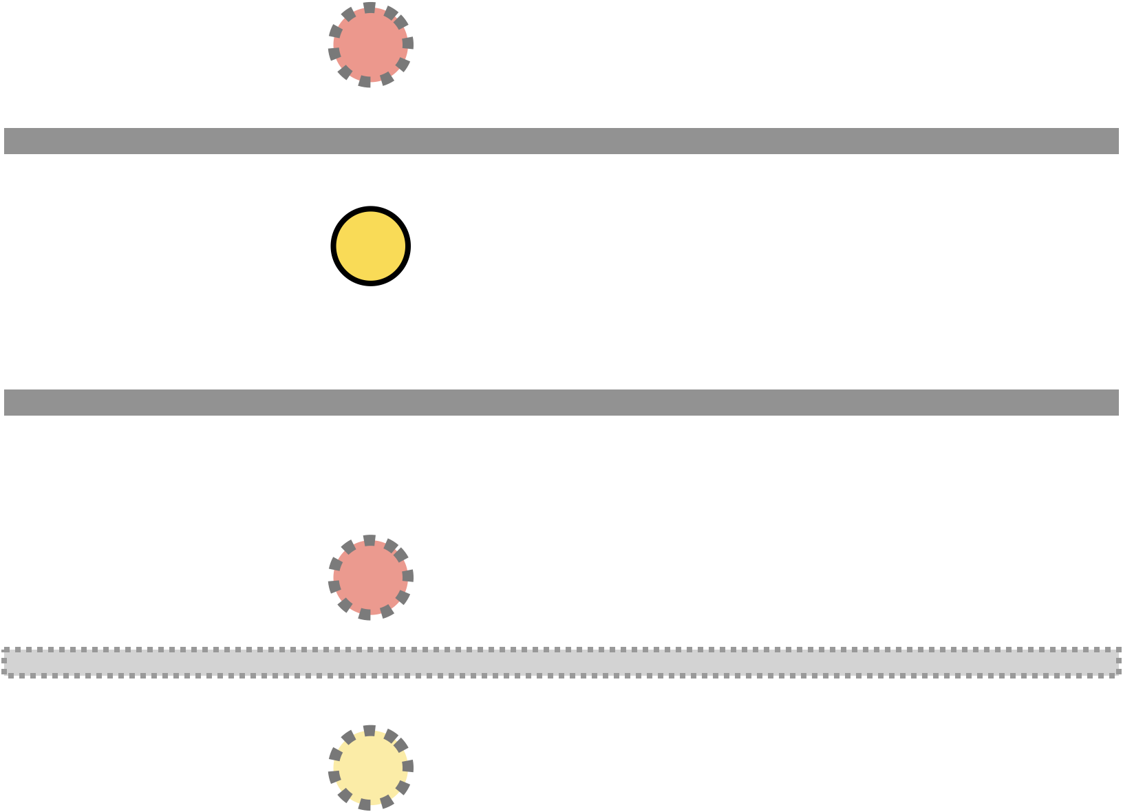
Point charge approach
For a point charge in a parallel plate, the analytic field expression involves infinitely many mirror charges
These can be expressed as an integral over a Bessel function
This is expensive to compute, so a grid is used for efficiency
We pre-compute the field maps on the grid and use symmetry to reduce memory usage
Mirror charges

Slide 17
Point charges
There is good agreement between free charged rings and point charges except at the anode
Here, mirror charges from the parallel plate boundary condition cause the field to be modified
Computation time and memory space are limiting factors
Comparison of the electric field for different approaches to space charge effect simulations

Slide 18
Summary of contributions
Implementation of the space charge effect for simulations using AvalancheMicroscopic and AvalancheMC
Refactoring of the charged ring code into ComponentChargedRing class
Significant optimisations made to existing functions
Investigation into the effect of grid spacing on the electric field
Investigation into the feasibility of grid-free simulations for the axisymmetric approximation, and implementation of divergence handling
Investigation into the effect of time window duration on gain
Investigation of the effect of space charge on gain for free charged rings

Slide 19
Future work
Run high-gain simulations for point charges with the PP boundary conditions to see if there is a more significant gain modification
Investigate the difference between the effect of space charge in a Micromegas and an RPC
Investigate multiple clusters vs a single starting charge
Investigate the effect of a resistive boundary condition on gain
Investigate the effect of changing ring the separation tolerance in the axisymmetric approximation
Find a way to increase the granularity of the point charge approach without compromising on memory usage

Slide 20
Questions

